Slide 1
Introduction to DAX
Frontline Analytics | Brett Powell

Slide 2
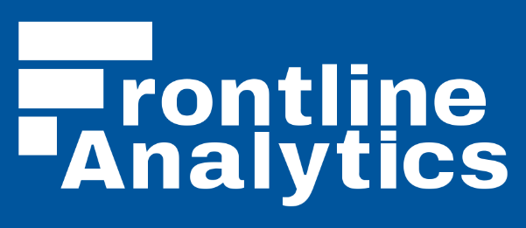


About
Owner, BI Consultant at Frontline Analytics
    FrontlineAnalytics.net
Blogger:
  InsightsQuest.com
Community:
  Boston BI User Group
  New England SQL Server
  Power BI User Groups
Brett.Powell@FrontlineAnalytics.net
@BrettPowell76

Slide 3


Goals for this session
Expose as much fundamental DAX in 60 minutes as possible
  30 minutes for concepts/slides
  30 minutes for code examples
See the bigger picture of DAX
  Use Cases, Tools, Roadmap
  Data Models and DAX Architecture
Core DAX Functions and Concepts
  DAX Metrics and Evaluation Context
  DAX Queries and new functions
  Learning Paths

Slide 4
agenda
What is DAX?
  Why Learn DAX?
  Where DAX fits in Microsoft BI?
The Fundamentals
  Data Sources, Models, and Data Types
  DAX Architecture: Formula Engine and Storage Engine
  Evaluation Context: Row and Filter Context
  Core Functions and Categories of Functions
Use Cases and Examples
  DAX Measures, DAX Queries, Row Level Security
DAX 2015: New Functions and Variables
Design Considerations:
  Performance, Complexity, Maintainability
Notes:
May require more than one slide

Slide 5
Part I: theory and concepts

Slide 6
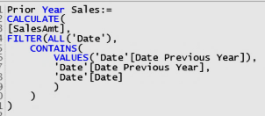
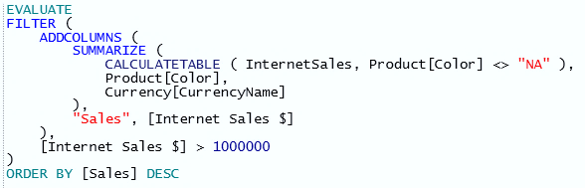
WHAT IS dax?
Functional Programming Language
  Functions return scalar values and tables from data models
  Used by Power BI, SSAS Tabular, and Power Pivot for Excel
  Analysis Language; Read Only
    Metrics and Queries Evaluated at Query Time
    Optionally persist DAX tables & columns at Process Time
Primary Objectives for Developing DAX:
  Accuracy: Expected Behavior in all contexts
  Speed & Scale: Efficient use of model & engine
  Sustainable: Standard patterns, readability
Five High Level Questions:
  Are we using DAX for analysis work? (not ETL)
  How will the expressions be evaluated?
    Self-Service, Local Query, User or Role Specific
  What Storage Engine will service our queries?
    Relational Database, SSAS Tabular?
  Are our critical metrics and queries efficient and scalable?
  Is our DAX Sustainable?

Slide 7
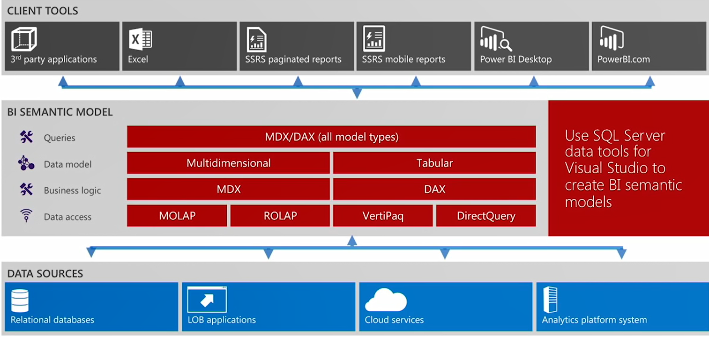
The Business logic of the model
Author DAX metrics and queries for Tabular & Power BI Data Models
  Client Tools: Both DAX and MDX client tools respect DAX functions defined in model
  Data sources: DAX is either converted to SQL (DirectQuery) or computed internally by VertiPaq Engine

Slide 8
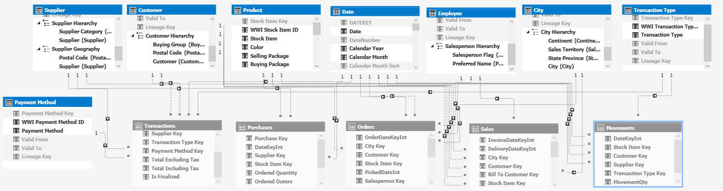
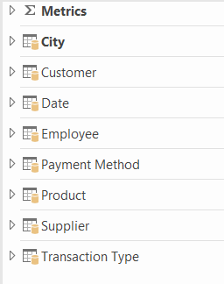
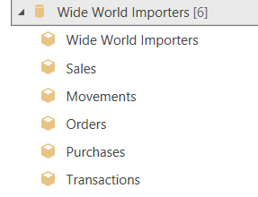
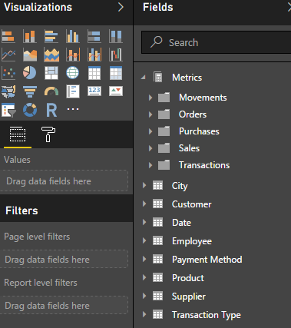
Inside the model
Models make data usable for analysis; representations of business processes and events
Tables | Relationships | Measures | Hierarchies | Folders
Table Partitions | Security Roles | Perspectives | KPIs | Metadata
DAX and model abstract away complexity
to provide ‘it just works’ experience for users
User only sees relevant content (e.g. Sales Team)
Queries respect mode logic and metadata
Optionally use DAX individual user dynamic context

Slide 9


WHY LEARN DAX?
DAX is now the primary analysis language of Microsoft BI
  Author in SSAS, Power BI Desktop and Power Pivot for Excel
  Enhanced SSAS Tabular 2016, New DAX Functions and Variables
  Azure Analysis Services (Preview, Currently Tabular Only)
Models Are Needed, with or without the data
  Simplified Interface, Platform for Self-Service and BI Development
  Version Control, Security, Performance, Custom Requirements
  Direct Query Now a Viable Option; Leverage DW/Relational Sources
Reasonable Learning Curve
  Simpler than MDX; Can benefit from SQL and Excel experience
  Target core concepts and functions for accelerated growth
  ‘Composable’ Functional Language becomes easier to author and understand

Slide 10
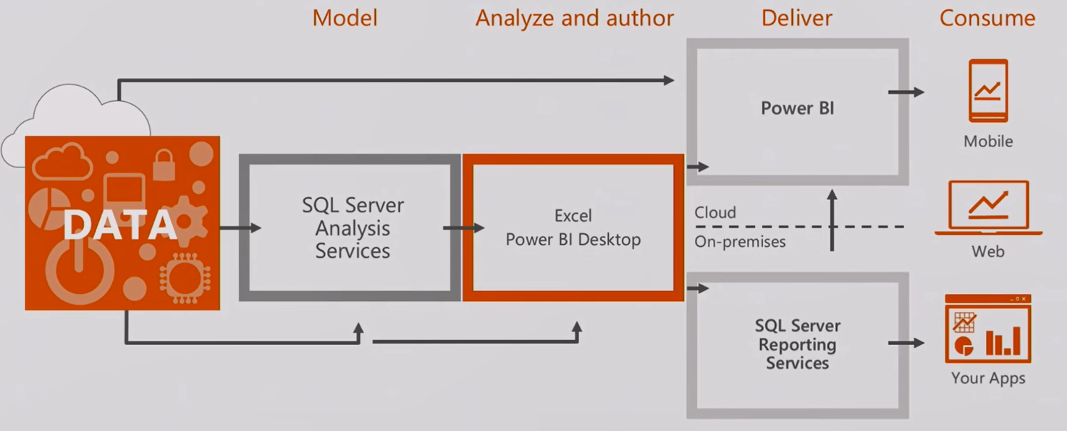
dax project and deployment types
Cloud or On-Premises Reporting and Visualization:
  Power BI Desktop (.PBIX) is published to Power BI Service or SSRS 2016 On Premises (Preview)
Corporate or Self-Service BI:
  Corporate: SSAS Tabular as source for Excel and/or Power BI Desktop; optionally for SSRS queries
  Self-Service and Pilots: Modeling with Power BI Desktop or Power Pivot for Excel

Slide 11
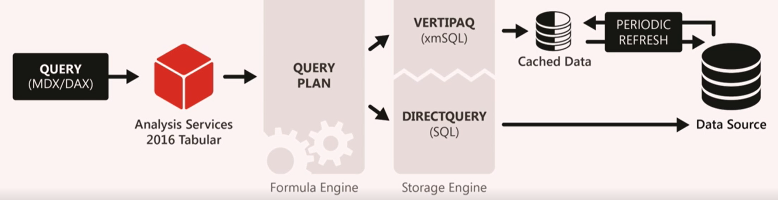
The DAX Query Engine
Formula and Storage Engine work together to resolve queries from client reporting tools
Formula Engine
“The Brains”
Produce Query Plans
Requests data from SE
Evaluates Complex Logic
Only Single-Threaded
Storage Engine (VertiPaq)
“The Muscle”
Return data caches to FE
  Vertipaq Cache
  Simple queries only
Multi-Threaded
Request
Data Caches
Query performance is improved by pushing logic to storage engine and reducing # SE of queries
Different query plans and performance depending on client tool (MDX or DAX); Power BI is optimal
Prior DirectQuery version was very limited: DAX clients only, SQL Server only, poor performance

Slide 12
DAX Architecture: Two Engines
Formula Engine:
  Main Function: Generate Efficient Query Plans
  Single Threaded but fully functional – can handle all DAX functions
Storage Engine
  Main Function: Produce Data Caches for the Formula Engine (Quickly)
  Stores cache of previous query result sets
  Multi-Threaded but limited to simple functions and relationships in the model
DAX Query Evaluation Process: Import Mode or Direct Query Mode
  Received by the Formula Engine from DAX Client Tool
  FE Generates Logical and Physical Query Plan
  FE Checks if Required Data is Stored in Cache; Retrieve from cache if available
  Sends Requests to Storage Engine – either SQL Statement or SQLml
  Storage Engine Dispatches CPU Thread per Segment Needed (if available on CPU)
  Data Cache is Returned to Formula Engine for final processing

Slide 13
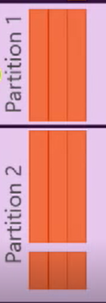
Think in terms of column segments
For Import Mode models, data is stored in compressed column segments
1 column segment per CPU Core; 8M rows per column segment (default)
Memory Size of segments and # of segments used in queries drives performance
Model Processing Process
Unique Values of column are encoded, stored in dictionary
  Integer columns may be Value Encoded
Sort Order Determined by Model; limited by Timebox setting
Run Length Encoding is performed by segment to compress data
  Repeating values are compressed
Each Partition has independent segements
Hierarchy and relationship structures stored and updated separately
Calculated columns are computed; not compressed
Cardinality and distribution of values primarily drive segment size
Can improve compression by increasing segment size; (at expense of longer processing times)
Can drive optimal compression and segment elimination via Order By

Slide 14
Build dax on a sound foundation
Sound models and hardware simplify DAX development and tuning efforts
Migrate logic from DAX to Model and from Model to Source System when possible
Leverage storage engine
Leverage efficient/selective filter conditions
Minimize materialization of temporary tables
DAX
Model
Hardware
Limit iterating functions
Avoid FILTER() if possible
Operate on columns
Minimal columns required
Minimal row grain required
Minimal data type precision
Optimize priority columns
Build star schema(s)
Avoid Calculated Columns
Analyze Compression and Partioning
If DirectQuery Mode:
Evaluate hardware and performance of source (Teradata, Oracle, SQL, APS)
If In-Memory Mode:
Consider speed of CPU and RAM, # of Cores if large models, NUMA Awareness on VM

Slide 15

Before dax: Model and hardware
In-Memory Mode Model
  Careful selection of row granularity and column cardinality
  Analysis of compression and partitioning (8M row default)
  Analysis of memory settings and optimal sort order
Direct Query Model
  Referential Integrity to Support Inner Join Queries
  Simple Views of Source Data for Query Plans
  High Performance Source:
    Massive Parallel Processing (MPP) Appliance: APS, Teradata, Oracle; SQL Server with Columnstore Index or optimized schema?
Scaling Up and Out:
  Preferred In Memory Hardware: 3Ghz+ Clock, 2133 Mhz+ RAM, large L3 cache
  Scale Up: More memory and CPU cores to accommodate larger models with more segments
  Scale Out: Load balance multiple SSAS Query Servers to address concurrency

Slide 16
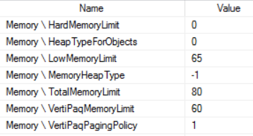

Before DAX: Red lights!
Out of Memory
  Over Memory Limits
  Queries and processing paging to disk
Model source queries pointed directly to source tables
  Processing will fail when source table changes
Disparate Data Types Used for Relationship Columns
  Example: Text to Integer can cause failure, errors
Dimension Tables with Duplicate Keys (or potential for dupes)
  Relationships require distinct values on one side
NUMA Awareness: SSAS Tabular 2012-2014 Not Numa Aware
Mixed Granularity of Fact Table Rows
  Will significantly add to complexity of mode and DAX

Slide 17

Before dax: Yellow lights
Calculated Columns on (large) Fact Tables
Unnecessary columns loaded to model
Decimal Data Type when Currency/Fixed Decimal suffices
Model Table Source SQL used as ETL layer
  Layers of views on views, complex logic, CTEs, Unions, etc
Snowflake Schema or Fact to Fact relationships
Limited Tabular Experience, Hubris
  Accidental BI, Power User, MOLAP Pro
  “It’s in memory, it should be fast”
No knowledge of top/critical queries and columns
Inefficient Partition Sizes reducing compression
Lack of Support for Early Arriving Facts
Silo Model: Different definitions used in other models or reports
FILTER() used inappropriately
Wide ‘Extract Report’ Requirements

Slide 18
Super dax: it’s just faster now
Models in Tabular 2016, Power BI, and Excel 2016 will perform better out-of-the-box
  Super DAX Details
Measure Fusion
  Single storage engine query for many measures from same table
Strict Evaluation of If/Switch
  Only true condition results in storage engine queries
Grouping Sets
  Single query at bottom level of hierarchy is used to support results at higher level
Join Orders
  Evaluation uses most restrictive intermediate table first
Power BI visuals were optimized to use new functions and variables in queries
Better SQL queries generated for Direct Query models

Slide 19
Part II: DAX fundamentals and samples

Slide 20
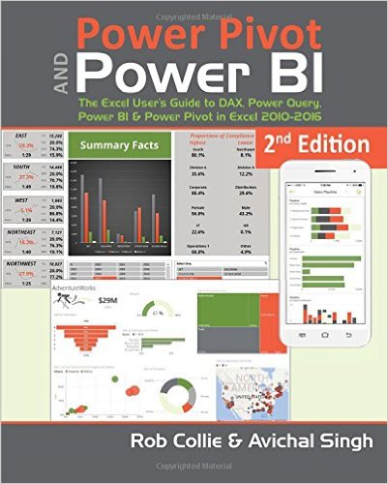
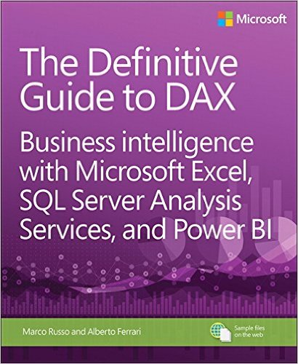
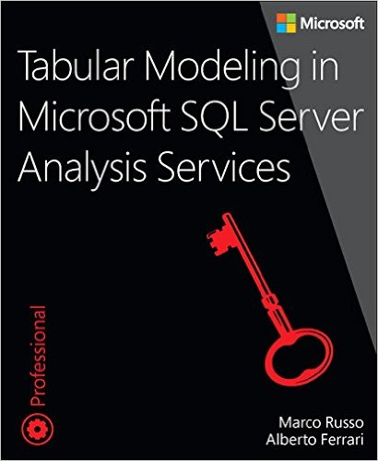
HOW TO LEARN DAX?
Write It:
  Free Dev Instance
  Development at work
    Experiment, Test
Analyze It
  Explain results
  Explain performance
Study It
  Start with PowerPivotPro, then upgrade
  Read and write blogs
Concepts to Focus on:
Evaluation Context: “Which rows are active to be evaluated?”
  Filter Context and Row Contenxt
Context Transition: Row Context to Filter Context
New DAX Functions and Variables

Slide 21
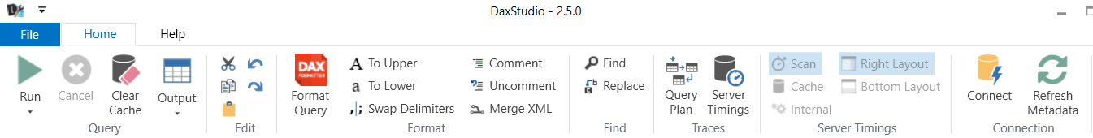
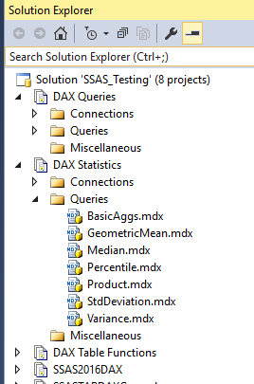
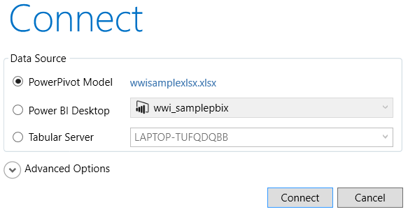
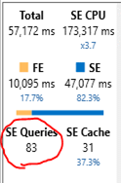
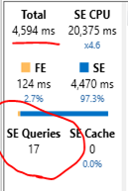
DAX Test and tuning tools
DAX Studio
  Full Authoring Experience: Intellisense, DAX Formatter, Functions, Model Metadata and DMVs
  Flexibility: Connect to SSAS Server, PBI Desktop and Power Pivot Models; Direct Query Supported
  Performance Tuning: Profiler Trace Events and Query Tuning Analysis built-in
SQL Server Management Studio (SSMS)
  Solution Structure and Admin/Management Functions of SSAS Database
  Minimal DAX Authoring Support currently
SSMS

Slide 22
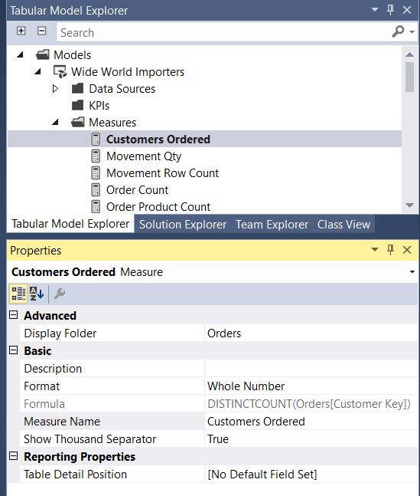
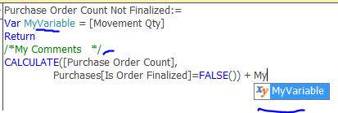
Authoring DAX in BI Projects
SQL Server Data Tools (SSDT) Projects for SSAS Tabular
  Significant improvements in SSAS 2016; Updated Monthly
    Intellisense, Formatting, Comments, Variables
    Tabular Model Explorer, Display Folders
    Integrated Workspace: No need for workspace SSAS server
    Much faster to implement changes to model and DAX
  Currently author metrics in Excel-like grid of a table
    No dedicated interface or right click option for new measures
Power BI Desktop (Updated Monthly)
  Formula Bar in Report/Visualization and Data Windows
  Right-Click in Report/Visualization and Data Windows
Power Pivot for Excel
  Dedicated DAX measure Authoring Window
  Also data grid and Right-click from PivotTable Window

Slide 23
DAX Data Types
Two Main Types: Numeric and Not Numeric
Numeric: Can apply DAX functions
  Whole Number: 19 Digits of Precision
  Fixed Decimal Number: 19 Precision, Scale of 4 (19,4)
    ‘Currency’ in SSAS Tabular and Power Pivot
  Decimal Number: 15 Digits of Precision
    Floating point; Approximate
  Date: Internally stored as floating point
    Integer Part: # of Days after 12/30/1899
    Decimal Part: Fraction of day in seconds (1 / (24*60*60))
  True/False (Boolean): TRUE = 1, False = 0
Non Numeric:
  Text: Unicode String, Case Insensitive
  Binary/BLOB: Not Accessible by DAX
Model Design Considerations
Whole Numbers for optimal performance
  Value Encoding and Compression
Fixed Decimal instead of Decimal Number if sufficient precision
  Avoid rounding errors
  Support for larger numbers
  Better performance than Decimal
Avoid Implicit Type Conversions
  Errors and Performance Degraded
Date Relationships
  Ensure all date values or use YYYYMMDD Integer

Slide 24
DAX Syntax and operators
Table with spaces: ‘the table’[column]
Table without spaces: thetable[column]
Measure: [My Measure]
Define Measure: TableName[My New Measure]
Column from result set table: [The Column Name]
Type | Symbol | Use
Parenthesis | () | Precedence Order Grouping Arguments
Arithmetic | +, -, *,/ | Basic Arithmetic
Logical | &&, || | And, Or conditions
Text Concatenate | & | Concatenation of strings
Comparison | =, <>, >=, <, <=,> | Equal, not equal, greater or less than

Slide 25
Core Functions to build around
Basic Aggregates
  Sum, Min, Max, Average
  Countrows, DistinctCount, Divide
VALUES
  Return a single column table of distinct values
FILTER
  Add an additional filter to the existing filter context
  FILTER(<table>,<filter expression>, <filter expression> )
ALL
  Return a table AND Remove filters from the given table/columns
  See different versions in sample code

Slide 26
Level Two Functions
RELATED and RELATEDTABLE
  Traverse relationship from Many to One side and vice versa
Date Time Intelligence
  Dedicated DAX Date/Time functions for standard calendar
  Compose Functions to work with Custom/Financial Calendar– FILTER and ALL
‘X’ Iterators
  SUM(X) – apply aggregation over a row-by-by calculation
Conditional Logic:
  IF, SWITCH, AND, OR
  HASONEVALUE

Slide 27

Calculate: most powerful function in Dax
Most powerful, useful, and complex functions in DAX
Same rules and behavior: CALCULATE and CALCULETABLE
Only functions that provide filter context modification:
  Add to existing filter context if no conflict with existing
  Overwrite existing filter context if conflict
  Ignore an existing filter if it exist
  See samples in demo
Calculate(<expression>,<filter1>,<filter2>…)
  Only <expression> is required
Rules for both functions:
  Filters can operate on a single column only or single table
    Product[Color] = “White”, Product[Price] > 5
    All(Product)
  Simple operators only, not measures
  Filters evaluated independently; combined in logical AND
  Expression is evaluated in the newly created filter context

Slide 28
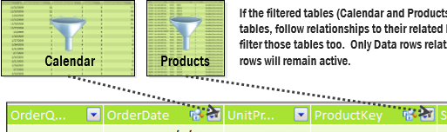
filter context in context
What is Filter Context?
  “What rows are ‘active’? given….
    Table Relationships
      (Many to One, Bi-Directional?)
    Report Filters at Client Level?
    FILTER() or ALL() applied?
Steps of Evaluation Context (Run Time)
  Initial filter selections applied to tables (slicers, rows/columns, filters)
  CALCULATE alters initial filter context if applicable (add/remove/modify)
  Each table is reduced to a set of active rows
  The active rows traverse relationships to filter other tables
Arithmetic of the measure is evaluated against this final set of rows

Slide 29
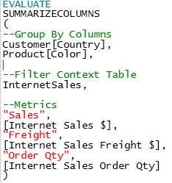
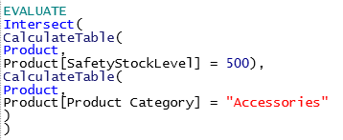
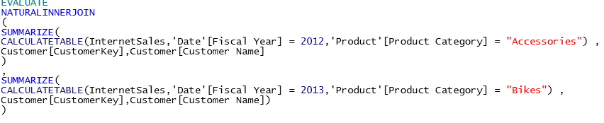
Variables and new dax functions
Exclusive to Power BI, SSAS Tabular 2016, and Excel 2016
  Used by Power BI visuals to drive greater performance
VARIABLES
  Store scalar value or table in a variable and reference in expression
  Leverage single evaluation multiple times to improve performane
Set Based Functions:
  INTERSECT, EXCEPT, UNION
Query Language:
  SUMMARIZECOLUMNS,
  NATURALINNERJOIN, NATURALLEFTOUTERJOIN
DATEDIFF
ISEMPTY
New STATS Functions
New MATH Functions

Slide 30













Boston Code Camp 26 - Thanks to our Sponsors!
Platinum
Gold
Silver
Bronze
In-Kind Donations

