Slide 1
Welcome!
Power BI User Group (PUG)
New York

Slide 2
Power BI Dataset Design
Brett Powell
BI Consultant, Author

Slide 3
Objectives
Definition of Datasets
Dataset Design Process
Import vs. DirectQuery Factors
Managed Data Access Layer
Relationship Types and Patterns
Usability Tips and Examples
Performance and Scalability Tips
Notes:
Dataset Definition: Clear distinction between datasets and reports (both PBIX files, different technologies and roles)
Dataset Process: Standard methodology you can apply (top priority: reusability – not duplicating datasets) and we’ll be walking quickly different components
Import v: DQ: Essential part of the design process (#2) – implications for how you design your dataset and what it can deliver
Managed Data Access Layer: It’s more than just clicking – ‘Get Data’ and maybe using the Query Editor UI; especially when you’re building a larger dataset, depend on clean, flexible retrieval
Relationships Types and Patterns: Single and Bidirecational, Active and Passive, for directQuery we have Assume Ref
Usability Tips and Examples: Can we have a large, complex model (many measures and tables) that’s still easy to use for self-service reporting and understand internally
Performance and Scalability: As model takes on more data, more users, more complex logic there are some design practice for the model and DAX measures to help you get more value out of your datasets

Slide 4
Session Agenda
The Role of Datasets in Power BI
Planning Scalable Datasets
End-to-End Dataset Development
  Data Source and Access Layers
  Data Model and Metadata
  DAX Measures and Client Interface
Tips and Examples:
  Usability
  Performance and Scalability
  Analysis
Notes:
We’ll start out with slides for about 15-20 minutes for the three objectives
Advanced session, so we’ll be into the dataset
We’ll use the remaining time for demo/examples in Power BI Desktop and other tools to illustrate objectives 4 through 7
walk through SQL Server DW all the way into the dataset and
Bonus example (‘golden nugget’): of documentation of a dataset (measure definitions, relationships, columns, etc) we will get to as well
hopefully we have some time at the end for Q & A

Slide 5
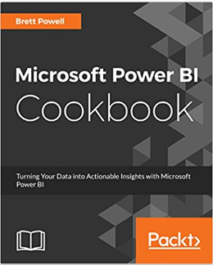
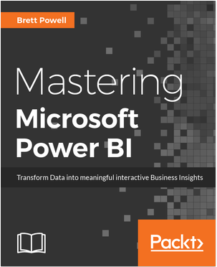


Meet Your Presenter
Boston BI User Group (PUG) Leader
BI Consultant, Frontline Analytics
Author of Power BI Book(s)
Blogger, Insight Quest
Sites:
  http://insightsquest.com
  http://frontlineanalytics.net
Contact:
  Email: Brett.Powell@FrontlineAnalytics.net
  Twitter: @BrettPowell76
  LinkedIn
Notes:
Boston PUG Leader – Monthly Meetings
Consultant Frontline Analytics
Author:
Cookbook coming out in a couple weeks
Mastering Power BI

Slide 6
Datasets in Power BI

Slide 7

Power BI Datasets Defined
Analytical Data Models (not Reports)
  Platforms for Reporting & Analysis
    User Interface for Client Tools
    Embedded Business Logic
  Reports connect to Datasets
Dataset Layers:
  Data Access and Transform (M Query)
  Data Model (Import or DirectQuery)
  DAX Measures
Calculations
DAX Measures
Data Model
Hierarchies, Metadata
Relationships
Queries
Transformations (Optional)
Data Source(s)
Tables, Columns (Types)
Tables, Columns (Types)
Three Layers of PBI Datasets
Notes:
A Power BI Desktop file can be a report but it can also be a dataset (or data model, could call it cube)
I have four files open – two are reports and two are datasets
Reports: only the visual layer (and local measure)
Dataset: relationships view, data access view, security roles
By Report, we exclusively mean the visualization layer (and maybe some local measures)
the last thing you would want is to have many reports with their own dataset (chaos, misuse of resource)
or dashboards that are in effect built on top of many datasets
By Dataset we mean enabling reporting and analysis
we want to make it as easy as possible to build as the most useful reports and analysis
the dataset (and it’s source) has already resolved many of the complexities and technical items (business)
Three layers of datasets (what are we building on top of?)
M Queries either land data into the data model or, if DQ, it only defines the semantic layer
Relationships make the model powerful useful, filters just flow across
then we build calculations that take advatnages of this model, sometimes add to it, overwrite it, etc

Slide 8
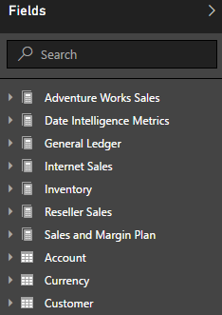
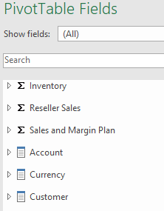
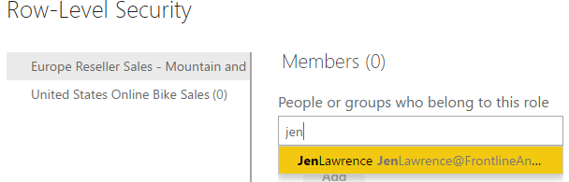
Dataset Design Objectives
Intuitive User Interface
Version Control; Reusability
Data Security
Query Performance
Scalability
Analytics
Availability
Manageability
PBIX Report: Live Connection
Power BI Publisher for Excel
Assigning Users/Groups to Row Level Security Roles
Notes:
Two takeaways:
A) you can’t really fail at any one of these (ie performance)
B) these factors push against each other over time (intere
Here are 8 top objectives when designing datasets.
Three points about these 8:
Very rarely do you just build a dataset once and not need to start at least tweaking it to support new business needs or changing needs.
If you take this approach, business might go off and build their own or export to Excel
They push against each other – you have to make tradeoffs sometimes:
I can make it intuitive and fast with just internet sales and but now we have more fact tables, relationships, metrics, statistics in model at scale
Not all of this is the responsibility of the dataset designer
An irresponsible report author building ‘extract’ like visuals
Intuitive UI: How difficult is it to build a useful or common report from scratch? (How many clicks?)
Version Control: The names of the measures and their logic align with the official definition (net sales exclude discounts or not)
Our measure (sales) ticks and ties to the official definition; with documentation…single version of the truth
Data Security: Row Level Security roles built into model
this is something you don’t have with Power Pivot for Excel; we can be confident that this group of users will only see this data, nothing more
might not have worry about this if you’re using DirectQuery with Single-Sign on via Kerberos
Query Performance: Obviously; if they have to wait for more than a few seconds it’s not good
Are our most common DAX measures efficient? Are they using the CPU cores available to them? (You can spend on hardware but if your DAX measure runs in a single thread, problem)
Scalability: maybe you’re already at 20 million rows and 500 MB; are there things we can do to improve compression and thus fit more data or just reduce the dataset size
we will get into Power BI Premium and Analysis Services as well
Analytics: Does our dataset only have basic sums and counts or maybe a level up with date intelligence, exceptions, statistics, or much more
Are users exporting data? If so, there’s probably some logic that needs to be added
Availability: How confident are we that this dataset is going to continue to refresh and/or remain functional for our dashboards and reports
are there dependencies that we can avoid or build logic to handle errors?
Manageability: How difficult or time consuming is it to make a change or troubleshoot an issue (e.g. switch data source (hard coded?)
Is logic spread out across layers of the dataset – M queries, calculated column, then DAX measures referencing that calculated columns
You can make something ‘work’ tomorrow but there’s a hidden but real cost for that

Slide 9


Dataset Designers in Power BI Teams
Dataset Designers
Report Authors
Power BI Admin(s)
Collaborate with:
  Data Source Owners
  Report Authors
  Power BI Admin(s)
Data Access
  Privacy Levels
  M (or SQL)
  Authentication
  Data Refresh
Data Model
  DAX Measures
  Security Roles
  Metadata
Collaborate with:
  Business Users
  Dataset Designers
Reports and Dashboards
  Design Standards
  Interactivity
Mobile Experience
  Mobile Optimized
Content Distribution
  Apps
  Subscriptions
Support Self-Service
  Analyze in Excel
Collaborate with:
  O365 Global Admin
  Governance Team
  BI Team
Tenant Settings
  Security Groups
Premium Capacity
  Capacity Allocation
Power BI Licenses
On-Premises Gateway
Usage Monitoring
Resource Monitoring
Organizational Policies
Notes:
So with those eight items and with previous slides you can think of at least three different Power BI roles with a dataset designer being one of them
Two Points:
Each role requires some level of competency in a specific area
Dataset designers – DAX, M, Data Modeling, source
Report Authors – Visualization Standards, Stephen Few;
Often business users or deep business knowledge
Power Admin – Tenant Settings, Power BI Premium Capacity Allocated
Relatively few dataset designers (working on few datasets – again, we don’t want many datasets)
Examples of Dataset Designer:
Data Source Owner(s) advise of a change to the source database (e.g. “we’re upgrading from SQL 2012 to SQL 2016, we thought you might want to know”)
Report Author advises: “I’m not able to build this report because we don’t have this measure
Maybe work with the PBI Admin on moving an App Workspace to Power BI Premium

Slide 10
Planning Datasets

Slide 11
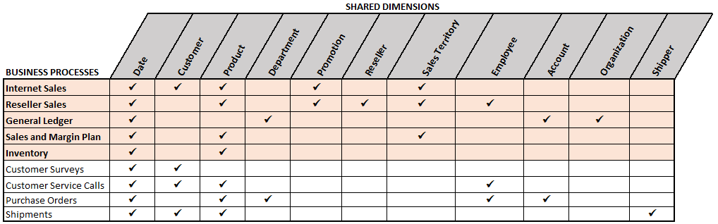
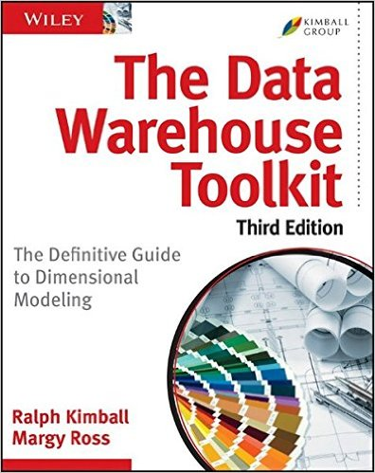
Four Step Dataset Design Process
Data Warehouse BUS Matrix
Identify the Business Process
Declare the Grain
Identify the Dimensions
Define the Facts
Expand and iterate on models:
New metrics and attributes
New fact and dimension tables
Revised Definitions
Performance Tuning
Notes:
Start at a Logical Level:
Emphasis on Reusability and Version Control (doesn’t mean there aren’t tweaks)
You wouldn’t want to build one dataset for marketing and another dataset for sales team that both had sales.
You wouldn’t want to build a dataset for this VP
BUS Matrix is a tried and true planning and communication tool
We have sales and plan but not POs, and Shipments; it’s coming
Greg Baldini is giving a presentation on dimensional modeling tomorrow; might go into detailed matrix)
Shared dimension: We have a Product dimension table and you can use it to filter the
Business Process:
Fact Tables – typically reflecting transactions but also snapshots such as inventory
Separate fact tables for separate processes (don’t try to consolidate into one) – each row should have the same meaning
Declare the grain
What does each fact table row represent? (one row = each line on a purchase order or each leg of an overall shipment)
Greater detail available versus more data to process and store or query
Dimensions
who, what, when, where, why associated with business process
What makes the model powerful and re-usable – slice reseller and online by promotion
Want to be careful with cardinality of the dimension – sometimes add a separate dimension and FK for performance
Facts
By ‘sales’ is that sales that have shipped, does it include discounts? does it include returns?
This ties to our GL or that system or it doesn’t but we know exactly why and we’re okay with it
may have to revisit the grain step based on the dimensions and facts
Note: You might consider a detailed matrix that has the grain and the facts defined

Slide 12

Dataset Planning
Where is the data?
  Cloud, On-Premises, Both
  Databases, Files, Both
How much integration is required?
  Where can/should it be implemented?
Are we targeting DirectQuery?
  HTAP (Hybrid Transactional Analytical)
  Implications for Data Source
  Implications for Dataset
Integrate and transform before PBI Dataset if possible (1-3)
If not possible, write efficient M queries (4); DAX as last option (5-6)
Plan
Data Sources
Sales
General Ledger
Inventory
Data Warehouse
ETL/ELT Data Transformation Process
1
Fact and Dimension Tables
2
SQL Views
3
Power BI Desktop
M Queries
4
DAX Calculated Tables and Columns
5
DAX Measures
6
Notes:
What are we building our dataset on top of?
Can we provide a robust source for our dataset such that we don’t have to massage and enhance data in Power BI and we can be confident in availability, scale, query/refresh, ettc
Power BI can apply logic to data in steps 4 through 6 but not a replacement for data warehouse architecture, enterprise ETL –
In my experience there’s always ‘some’ logic that needs to be applied in the dataset; which you’d like to move to DW – but this definitely has its limits and it will undermine your project at some point
Especially if you don’t implement it correctly:
You might add three calculated columns you didn’t need or maybe you did need those columns but you could just add them to the M query and they get compressed
Where is the data:
If the data we need is spread out across multiple databases and systems (Import)
If it’s on-premises we want to be sure we have on-premises gateway ready.
If it’s in the cloud but an IaaS source, we’ll also need a gateway.
If 90+% of data is in a data source supported for DirectQuery; we might have a decision to make
If a dataset is sourcing from on-premises and online sources then there are limitations
How much data integration:
Do you truly have a data warehouse or do you just have a copy of the transactional tables?
Do you have people and tools that do ETL/ELT? (maybe stored procedures?)
We rarely live in a perfect world where our DW has all the integration we need;
In many cases we can apply some logic in #4 and it still get folded back to our source
Performance and Manageability – imagine scenario of tracking down an issue (and you have logic at each of six layers)
Are we targeting a DirectQuery model?
HTAP: we want to provide near real-time Power BI reporting over our OLTP tables
BUT we don’t want to impact these systems at all
DirectQuery is the de facto option
Implications for Data Source: Are we using in-memory tables or columnstore indexes? that could make it possible
Do we have the ability to scale up our DQ source such as SQL DW (e.g. scaling up Azure SQL DW (300 DWU or 600 DWU)
Implications for dataset:
we want that access layer to be as efficient as possible with essentially no transformations in #4
Are we going to apply security in the DirectQuery model or use the security of the source database

Slide 13
DirectQuery Factors
DirectQuery Data Sources
  Single source and database
Scalability of Import Models
  Size limit; Full Refresh
  Analysis Services RAM; Migration
How complex is the model?
  Data Access and Analytics
Available Resources
  DW or DB Relational Database Skills
  Features and Hardware of Source DB
Power BI DirectQuery Data Sources
Amazon Redshift | Azure HDInsight Spark (Beta) | Azure SQL Database
IBM Netezza (Beta) | Impala (v 2.x) | Azure SQL Data Warehouse
Oracle (v12+) | SAP BW (Beta) | SAP HANA
Snowflake | Spark (v.9+) (Beta) | SQL Server
Teradata
DirectQuery Supported Data Sources as of 8/31
Notes:
There’s a 67-page white paper “DirectQuery in SSAS 2016” by Marco and Alberto; that largely applies to Power BI DirectQuery too. Two points
there’s no golden rule or clear methodology to follow – there are tradeoffs to consider
you’re going to give up some performance relative to in-memory even if you’re doing things right with DirectQuery
you might be okay with that for other reasons:
you have other reports hitting your relational system and you don’t want a copy of this data out there that you have to refresh
Single Database
Just want to emphasize that it needs to be in a single database:
you have some data in an OLTP database but you also have a few tables in DW or other databases.
Scale of Import Model (1GB)
situation: we don’t have SSAS yet and despite good design we can’t load all the data into PBIX with it’s current limit. DirectQuery is the only option – you don’t want to have separate import datasets.
That limit is expected to be raised soon
How complex is the model
If we need to apply transformations to the source tables then either A) this could severely hurt query performance and put load on the system or B) not all transformations can be folded back to the source so we might not be able to have a DQ
Are there DAX functions we need to run in calculations that don’t get translated into SQL statements? (Non-Optimized DAX functions)
https://docs.microsoft.com/en-us/sql/analysis-services/tabular-models/dax-formula-compatibility-in-directquery-mode-ssas-2016
Available Resources
Team is very comfortable with relational SQL and columnstore index
They can take care of this.
Maybe you’re running SQL 2008R2 and SQL 2016 is coming
Quick Note:
Azure SQL DW is not recommended as a DirectQuery source for Power BI for performance.

Slide 14
Scaling Power BI Datasets
Power BI Premium at GA
  Isolation (Noisy Neighbor)
  48X (vs 8X) Refreshes/Day
  Remove 10GB/User Limit
Premium Roadmap
  Large Datasets (1GB Current)
  Incremental Data Refresh
  Scale Out, Pin to Memory
Analysis Services
  Migrate PBIX to SSAS Model
  Azure (AAS) or On-Premises
  Partitions, Perspectives, Display Folders
  Source Control Integration
  Automation, Administration
Capacity Nodes | Backend Cores | Memory | Direct or Live Queries
P1 | 4 | 25 GB | 30/sec
P2 | 8 | 50 GB | 60/sec
P3 | 16 | 100 GB | 120/sec
Power BI Premium Capacities at GA (excluding EM)
Instance | QPUs | Memory
S0 | 40 | 10 GB
S1 | 100 | 25 GB
S2 | 200 | 50 GB
S4 | 400 | 100 GB
S8 | 320 | 200 GB
S9 | 640 | 400 GB
Azure Analysis Services Standard Tier Instances (as of 9/5/17)
Notes:
two takeaways: 1) we have a choice emerging in terms of SSAS or not and 2) we can save money by optimizing dataset
We have two main roadblocks to scaling a Power BI Dataset currently:
1GB file limit after import and compression
all or nothing refresh
“both limitations are expected to be addressed per the roadmap for Power BI Premium
This leaves an interesting choice that’s emerging:
A) Migrate to SQL Server Analysis Services (Azure SQL DB, DW, Oracle, and Terada)
Azure AS Web Designer: import a PBIX (import only currently)
Gives us partitions, perspectives, automation
B) Not migrate but use Power BI Premium features
I want to use my P2 capacity node
might start out with just one business process in your dataset and maybe you only need 1-2 years of
ultimately you’ll want more datasets history, more frequent
Even after we’ve done everything we our PBIX file we simple need more resources
more data to store in the dataset, more users to support, faster queries (
Efficient dataset design has its limitations
On the other hand, however, efficient design will help from over spending on capacity nodes. (e.g. single threaded queries)
Power BI Premium Capacity Nodes
At a minimum, we could just say 1 capacity node (P1) and point my Power BI free users to this premium workspace
We expect (based on roadmap) that larger datasets and incremental data refresh will be supported (no guarantee though or time)
Analysis Services
Migrate: Web Designer Tool -
The tools are close enough – we know DAX and Tabular – let’s build
Trade off here is that you might not be as agile as you are with a PBIX file
You also need to know how to manage SSAS Tabular – TMSL; TOM
Query Processing Unit: cores for processing and queries. 1 v core = 20 QPUs so an S2 with 200 QPUs is about 10 cores
Section: Dataset Development

Slide 15
Dataset Development

Slide 16
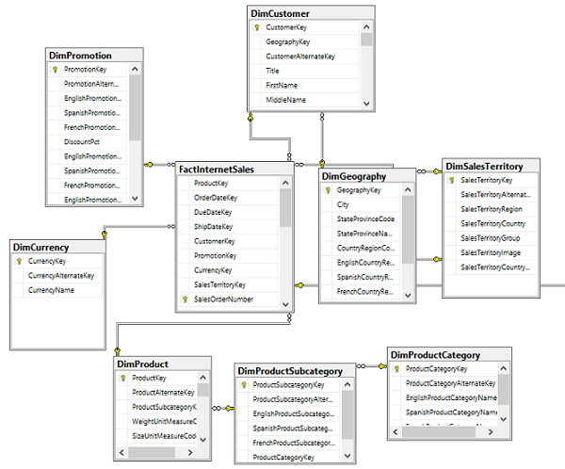
Data Warehouse Schema and Views
Dimension and Fact tables
  Referential Integrity
Robust Date Table
  Date Intelligence Columns
Slowly Changing Dimensions
  Historical Tracking
SQL Views for Dataset
  1:1 with Tables in PBIX
Database Diagram: SQL Server
Notes:
*Have SSMS solution open with diagram and queries
Diagrams: Start out with a map (SQL Server, Visio, Erwin)
Note dimension tables normalized more than we want (Product Cat, subcat, prod)
Tables:
You can see we have dimensions and facts
We have a fairly robust date table 46 columns (financial and sta)
Sometimes you’ll see example scripts or blogs to create a calendar table in Power BI with M or DAX (there’s an example in my book of M) but you shouldn’t have to
Views
Layer of views is what a Power BI dataset (or SSAS) will connect to
It’s recommended for decoupling the model from the source – announces to the DBA this is what we’re using, (doesn’t mean that’s all we’re using)
Quick example: view dependencies of promotion
Complete Date Table
Analysis will revolve around Date and Sometimes Time
Query 1: Date Dim Samples
Trailing three weeks, months
Query 2:
in this case we’re using some T-SQL functions go give us dynamic columns
we’re making it easy for the report author
if you load the date table nightly then this isn’t necessary
where clause in my date 2014 through today
Query 3:
three tables; left join because the FKs on product and subcat allow nulls
user friendly names, logical column
Note: if these were larger tables and we were targeting DirectQuery we wouldn’t want to be joining tables together and applying logic
Query 4:
We want to track the history of the product but we only want to count it once
We can now transition to our first demo: PBIX

Slide 17
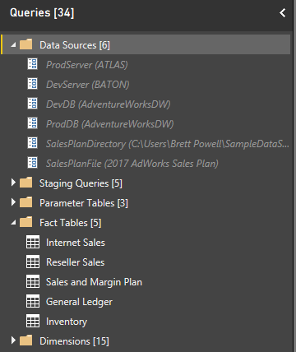
Power BI Data Access: M Queries
Data Source Parameters
  Prod vs Dev
Staging Queries
  Refresh Only
Query Groups
  Facts and Dims
Parameter Tables
  Load Only
M Queries
Notes:
Now that we’ve seen the SQL Server DW and View layer let’s access those views from an Import and a DirectQuery model
We’ll start with an import model and then we’ll open up the DirectQuery data access, it’s very similar (slight difference)
So we have queries spread across these groups
Notice that grayed out queries and parameters we’re not loading to the data model
Data Sources:
The main idea here is to isolate our data sources from our individual queries
Use parameters to hold data source values – make it easy to changem
In this model we have a SQL Server DB and we have one Excel file
Click Manage Parameters
Note how the grayed out queres – we’re not loading
Staging Queries
AdWorksProd query – exposing tables and views that we were just looking at in SQL Server
view in advanced editor: passing parameters to this function)
Dimension and Fact Tables (Advanced Editor):
Internet Sales query example (advanced editor):
Reference the AdworksProd query
record of this table
in this example, the view has integer keys for dates that I don’t need so we
notice View Native Query – very simple SQL Statement that does not ask for
Sales and Margin Plan Example
Passing in Excel path (SalesPlanFilePath)
Setting data types
General Ledger query example:
Using a separate query (CurrentDateQry) in a filter
it is also being folded back
Organization Example:
There’s a need to always show the US divisions next to each other in visuals
Technically we could just use the parent organization but this is a fairly common pattern
4. Parameter Tables:
Just placeholders to help the UI – see that they’re not being refreshed
reference our source, approve a nature query, pass a SQL statement)
quick note on native query – anything after it is local resources
quick note: current file parallel loading of tables (many queries at the same time, may not want that. May also want to reduce max degree of parallelism in SQL Server)
why have these? 1) create a display folder like effect for grouping measures (e.g. date intelligence) 2) split up DAX logic that is shared throughout the model
note that they’re only loaded once, not refreshed
tip: if you have something that just never changes like Time dimension or very rarely changes like the annual plan maybe you just load it once a year
now let’s flip over to the DirectQuery data access model
5. DirectQuery Differences:
Sales and Margin Plan is now in the Data Warehouse with a view (everything in one database)
AdWorksProd – we’re referencing the first expression and ignoring the account view (2nd line)
everything else is the same including parameter tables

Slide 18
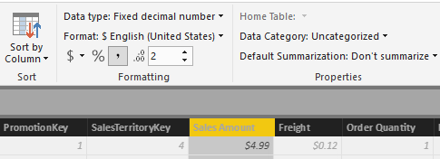
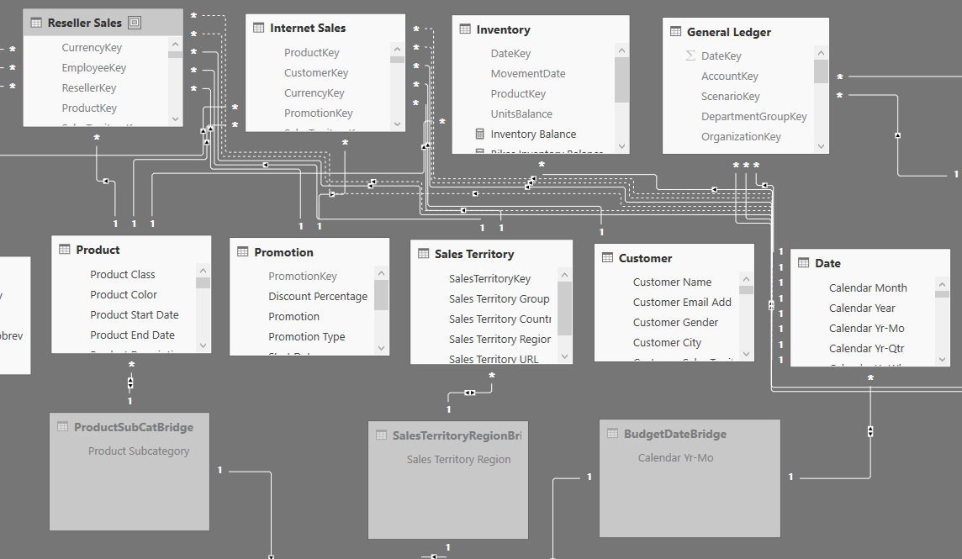
Power BI Data Models
Columns
  Data Types
  Sort By
  Properties
Tables
  Relationships
  Hierarchies
Measures
  Formatting
Column Properties and Metadata
Relationships View
Notes:
At this point:
our M queries have either loaded in the data for import models or,
if it’s DirectQuery, they’ve only defined the tables and columns of our model
I won’t demo the data types and metadata but I’ll briefly say a few things and then we’ll get into the relationships with a demo
open manage relationships
Tip 1: our data types for the relationships are aligned.
with the exception for Dates, these columns should be Whole Number or integer
the model will let you relate a text column to a whole number, but you shouldn’t do that (the bones of our model)
one side of the relationship has to uniquely identify each row of the table
Tip 1.5: from side fact tables, to side dim tables
Tip 2: hide everything except measures and attributes
don’t need to expose fact columns, don’t need to expose key columns (too much to browse)
every once in a degenerate dimension
note: measure support table is hidden, we still use these metrics but the user doesn’t see them
Tip 3: choose numeric data types carefully – Sales Amount of Internet Sales
numeric data types (Fixed Decimal Number)
whole number (19 digits of precision), decimal is a floating point with 15 digits of precision (approximate)
Fixed Decimal (19, 4) – 19 digits of precision (15 to the left of the decimal, 4 to the right) rounding eliminate rounding issues with decimal number)
Example: Customer Table
Tip 4: Turn off default summarization
by default every numeric column will have default summary
example: customer cars owned
Tip 5: Set Data Categories, geography and Web URL
example: sales territory URL
example geography
Note: What don’t you see in this model?
Answer: No calculated columns and no calculated tables
open Relationships window
explain bridge tables
explain parameter tables

Slide 19
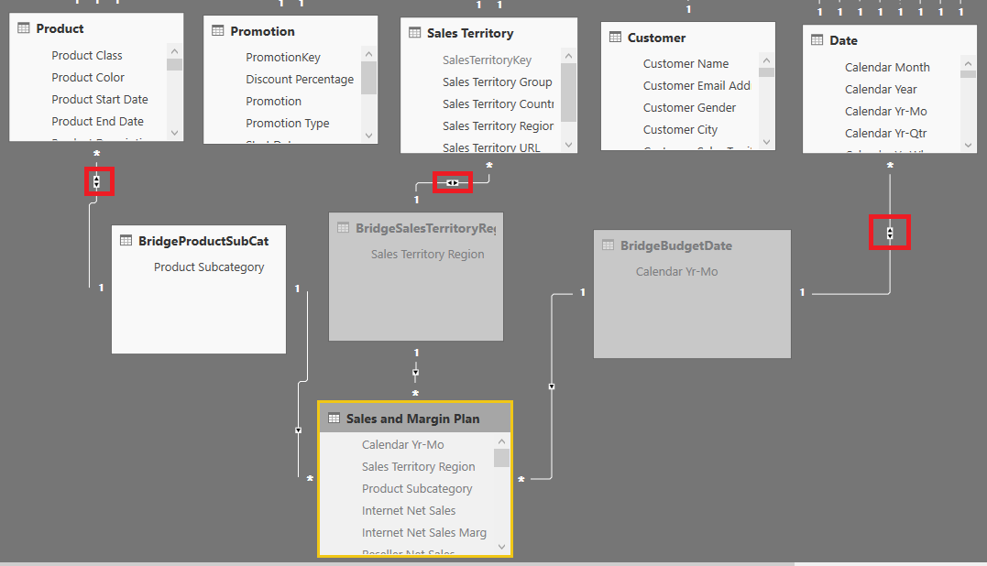

Relationship Pattern: Actual vs. Plan
Bridge tables
Relationships
  Bidirectional: Dim to Bridge
  Single: Bridge to Plan
Actual to Plan Measures:
  Check Filter Context
  Compare Actual to Plan
Return Blank if Filter Context Not Supported by Plan
Actual vs. Plan Modeling
Notes:
Actual vs. Plan Report page
If I choose product color it goes blank
If I choose weeks it goes blank
If I choose product category or country, we’re okay
If I drill down from month to week, it goes blank
The idea: we budget/plan at the Month, Region, and Subcategory level
Therefore, we want to filter by our existing Date, Territory, Product dimensions
BUT, we need to account for the filter context of when filter is bellow
Flip to relationship See where do bridge tables comes
Filter flows south to plan and north to our fact tables
Flip to query Editor
Example with product subcat: start with product table, give me distinct values of subcat
Note that all of these were converted to a SQL statement
Flip to Data View: Measure Support (hidden table)
See: Date Grain Plan filter test, Product Grain Plan Filter Test
See: Plan Grain Status Measure:
We’re checking if a filter has been applied at a finer granularity than Plan
See Internet Net Sales Var to Plan measure
Bidirectional Relationships – these are the only three bidirectional relationships being used
good for solving many to many problems, bridge tables for mixed grain, dynamic role level security
probably not what you want for most relationships, especially with larger and more complex models
never want a fact to date bi-directional relationship (bridge table)
example with support logic

Slide 20
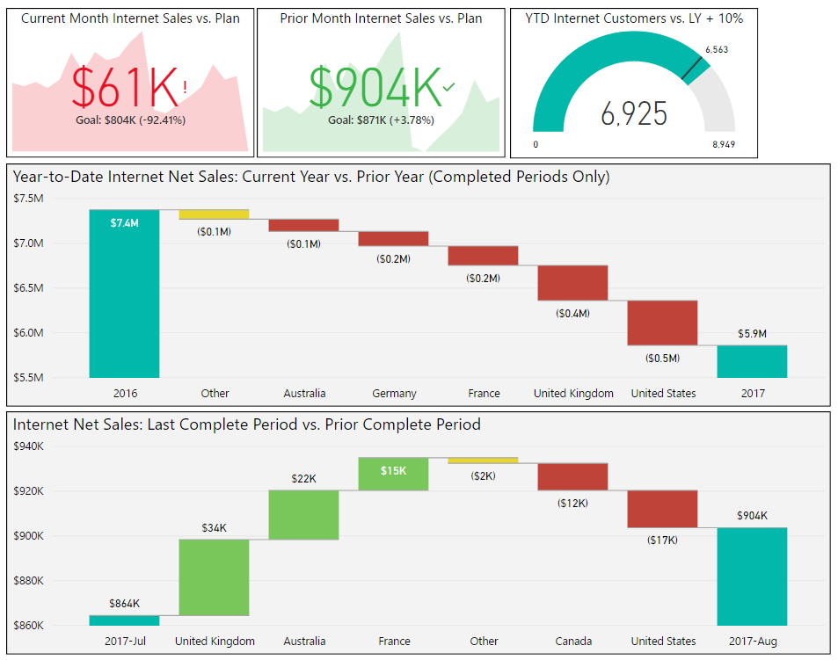
DAX Measures and Client Interface
Compare and Combine Facts
  Actuals versus Budget
  Online Sales Plus Store Sales
Dynamic Date Columns
  Report, Page, and Visual Filters
Date Intelligence
  Compare Common Periods
Target Measures
  KPI and Gauge Goals/Targets
Notes:
Open KPI Targets and Waterfalls
The point of this page is that dynamic date columns and DAX measures for target or goal values measures enables for more useful and easier to maintain reports
Current Month I Sales vs Plan
It’s using that Calendar Yr-Mo column for trend back to Jan 2016
Expose table of values
Prior Month vs Plan
Visual Level filter: is not current month (Calendar Month Status column)
YTD Internet Customers
Using a ‘Target’ metric for Prior YTD
Internet sales customer count – uses it’s alternate key
Find: customer count (PY TYD) measure (search customer count)
Waterfall chart (top)
We can just use the year column because of our report level filter
You couldn’t do this with the relative date filter (we want all of last year, and YTD). Relative Date filter
Waterfall chart (bottom)
Visual level filter: Prior calendar month vs. prior complete period

Slide 21
Bonus: Dataset Documentation

Slide 22
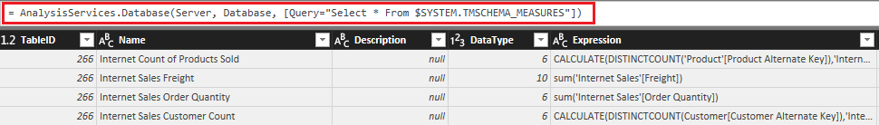
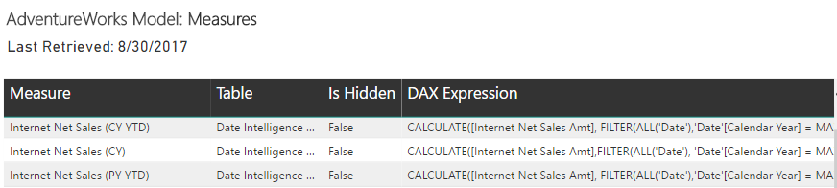
Power BI Documentation Dataset and Report
Identify SSAS Server and Database of PBIX via DAX Studio
Query SSAS DMVs via Analysis Services Connector (w/Params)
Integrate DMVs to form documentation tables
Retrieving SSAS DMV Metadata into PBIX
Sample Documentation Report Visual
Notes:
Open DAX Studio
Find Server and Database of AdWorksEnterprise
Note host
select
[CATALOG_NAME]
from $SYSTEM.DBSCHEMA_CATALOGS
Open the Dataset Documentation (maybe open this first; show you finish product)
Open Query Editor
Server and Database Parameters
DMVs versus Documentation Queries
DMVs: notice we’re using the new Tabular Model Schema DMVs
Documentation:
See the Relationship query – we join Tables and Columns together
See the metrics query: need the table of the measure
The point is: you need to join the DMVs together to make it more valuable

Slide 23
Performance and Scalability

Slide 24
Import Dataset Performance and Scale Tips
Date
Price
Qty
Sales
Order #
Import Mode
  High Cardinality Columns
  High Cardinality Relationships
  Optimal Sort Order
DAX Optimization
  Leverage the Storage Engine
  Early, efficient filters
  Limit iterations and complex row operations
1234
Segment 1
1 M Rows
2015
1.5
2
3
Segment 2
1 M Rows
2016
1.8
3
5.4
1235
Segment 3
1 M Rows
2017
1.9
2
3.8
1236
Import Mode Columnar Storage
Can fact table columns be removed?
Can DAX Measures eliminate the need for columns?
What is the optimal sort order?
Are there any calculated columns that can be replaced?

Slide 25
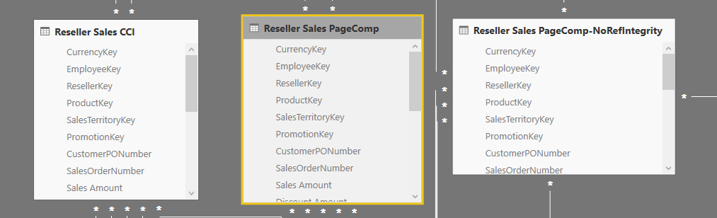
DirectQuery Performance Test and Tips
Optimize Data Source
  Columnstore Index
  Referential Integrity
  Efficient SQL Views
Optimized DAX Measures
  Use Storage Engine Functions
  See DAX Formula Compatibility in DQ Mode
Fact Table | Duration | CPU | Reads
Clustered Columnstore with Ref Integrity | 1.3 sec | 2.3 sec | 54K
Page Compression with Ref Integrity | 2.9 sec | 4.3 sec | 178K
Page Compression without Ref Integrity | 3.4 sec | 4.9 sec | 178K
DirectQuery Performance Test Results
Test Conditions
SQL Server 2016
  4 CPU Cores, MAXDOP = 2
12M Row Fact Tables
Common Report Query
  Sales by Month for a year
DirectQuery Performance Test Model

Slide 26
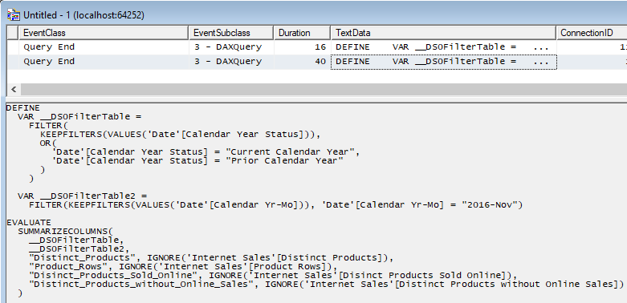
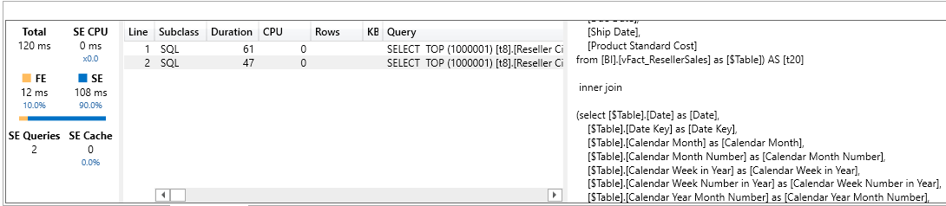
Capture and Analyze Power BI Queries
Retrieve DAX Query from PBIX
  SQL Server Profiler
Analyze Query in DAX Studio
  Import or DirectQuery
Retrieve SQL Statement of DirectQuery Model
Profiler Trace of Power BI Desktop Dataset
Analyze DAX Query with DAX Studio (Import Model)

Slide 27
Thank you for Attending!
Don’t forget to join your local PUG to enjoy year-round networking and learning.
www.pbiusergroup.com/NYNJ
www.pbiusergroup.com/philly

