Slide 1
Relationship modeling patterns in SSAS and Power bi
SQL Saturday Boston (9/23/2017)

Slide 2
Objectives
Relationship Fundamentals
Bidirectional Relationships
Dimension Measures
Actual vs. Plan (Multiple Grains)
Dynamic Row-level Security (RLS)
Virtual Relationship Patterns
Many-to-Many Relationships
Notes:
Quick Note: by SSAS I’m exclusively speaking about SSAS Tabular (and Power BI) (not multidimensional and not Tabular 2014 or earlier)
SSAS Tabular 2016 or later you can implement these patterns is the default installation in SSAS 2017
Considered ‘strategic’ for Microsoft given alignment with Power BI (same engine)Note that DirectQuery is also strategic
Relationship Fundamentals:
what are the rules of relationships
row identity, ambiguous relationships, active vs. inactive relationships,
how they impact filter context
Bidirectional Relationships:
Flow filter context from the many side of a relationship to the one side
What are some use cases and some anti-patterns for that
Invoke via DAX functions as well
Dimension Measures:
Simple pattern: count of customers or distinct customers:
who’ve bought and those who haven’t
slowly changing dimension ETL with multiple rows per customer
Actual vs. Plan/Budget:
Very valuable and common analysis but of course the Plan fact table is at a different granularity
We have two examples: one with physical relationships (more tables) another is virtual (all DAX)
Dynamic Row-level Security (RLS)
A user connects to the dataset and based on their identity a security filter context is applied
A great use case for bidirectional relationships
Virtual Relationship Pattern
I can’t create a physical relationship in the model so we handle it with DAX
Many to Many Relationships
A primary use case of bidirectional relationships
Many accounts for a customer and many customers for an account

Slide 3
Session Agenda
Part 1
Datasets:
  Power BI and SSAS Tabular Models
  Import and DirectQuery
Relationship Fundamentals
  Row Identity, Ambiguity
  Relationship Data Structures
  Filter Propagation
Part II
Pattern Examples:
  Single and Bidirectional Relationships
  Role Playing Dimensions
  Dimension Measures
  Actual vs. Plan
  Dynamic Row-level Security
  Virtual Relationships
  Many to Many
Notes:
Basically 15-20 minutes for Part I or the basics and then we’ll dive into all these 7 patterns
What’s in a dataset? There’s much more than just Relationships
Import vs. DirectQuery – this is going to be the question
We’ll start out briefly with Datasets (or ‘Data Models’ (or ‘cubes’)) in Power BI
We have two types of datasets or models and the relationships we define will be implemented differently based on the model we choose
Inner Join SQL Query based on the SQL Views we have for our model or is there an relationship structure stored in the dataset in-memory that gets processed
Patterns
Seven distinct relationship patterns here
The first 3 should be relatively clean/straightforward
The next 4 a little more complex because:
Use a combination of both single and bidirectional
Use some DAX code as well to implement

Slide 4
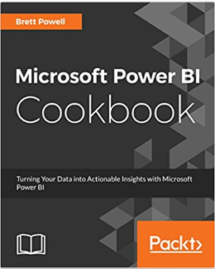
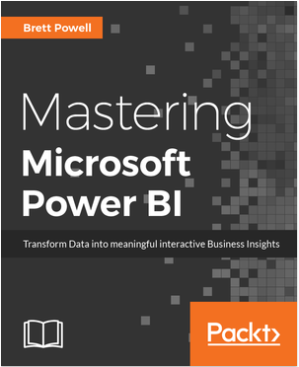

about me
Boston BI User Group Leader
BI Consultant, Frontline Analytics
Author of Power BI Book(s)
Blogger, Insight Quest
Sites:
  http://insightsquest.com
  http://frontlineanalytics.net
Contact:
  Email: Brett.Powell@FrontlineAnalytics.net
  Twitter: @BrettPowell76
  LinkedIn
Notes:
Boston PUG Leader – Monthly Meetings
Consultant Frontline Analytics
Author:
Cookbook coming out in a couple weeks

Slide 5
Datasets

Slide 6

Datasets Defined
Analytical Data Models (not Reports)
  SSAS Tabular Instance inside Power BI Desktop
  Platforms for Reporting & Analysis
    User Interface for Client Tools
    Embedded Business Logic
    Reports connect to Datasets
Dataset Layers:
  Data Access and Transform (M Query)
  Data Model (Import or DirectQuery)
  DAX Measures
Calculations
DAX Measures
Data Model
Hierarchies, Metadata
Relationships
Queries
Transformations (Optionally)
Data Source
Tables, Columns
Tables, Columns
Three Layers of PBI Datasets
Notes:
By dataset I really mean an SSAS Tabular model, or a ‘cube’, that serves as a platform for many reports
Normally when you see PBIX files you think of reports and dashboards; not row level security
A Power BI Desktop file can be a report but it can also be a dataset (or data model, could call it cube)
I have four files open – two are reports and two are datasets
Reports: only the visual layer (and local measure)
Dataset: relationships view, data access view, security roles
By Report, we exclusively mean the visualization layer (and maybe some local measures)
the last thing you would want is to have many reports with their own dataset (chaos, misuse of resource)
or dashboards that are in effect built on top of many datasets
Three layers of datasets (what are we building on top of?)
M Queries either land data into the data model or, if DQ, it only defines the semantic layer
Relationships make the model powerful useful, filters just flow across
then we build calculations that take advantage of this model, sometimes add to it, overwrite it, etc

Slide 7
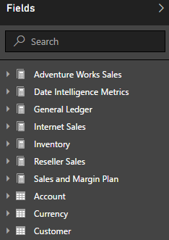
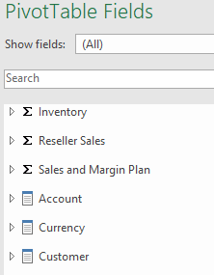
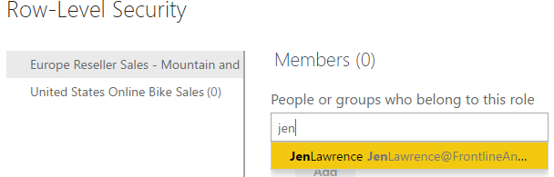
Dataset Design Objectives
Intuitive User Interface
Version Control; Reusability
Data Security
Query Performance
Scalability
Analytics
Availability
Manageability
PBIX Report: Live Connection
Power BI Publisher for Excel
Assigning Users/Groups to Row Level Security Roles
Notes:
Here are 8 top objectives when designing datasets.
A few points about these 8:
You can’t fail at any one of these such as query performance
7 of the 8 are directly impacted by the relationships
The objectives push against each other – more analytics, more data but keep everything fast and manageable
Relationship Examples of these objectives:
Intuitive UI:
User doesn’t see whether relationships are single or bi or if you have hidden tables that are used for security permissions or bridge tables
Version Control:
When we say of count of products, do we mean the count of products that have sold? If so, we might consider a bidirectional relationship to product table or a measure that invokes a bidirectional relationship
Data Security:
Common pattern: User signs into Power BI, their UPN is used to filter a User Table and that filter flows to security tables which then filter dimension tables and then filter fact tables
Query Performance: Obviously a critical requirement
If it’s a DirectQuery model, are inner join or outer join SQL statements being issued to my source?
If it’s an in memory model, the larger the relationship means the slower the query
Relationships are independent memory structures – a customer dimension table of 3 million rows will hurt
Multiple relationships to traverse? (we want a direct flight
Scalability: Maybe everything is fine at 25 million row sales table but at 100 million rows or a billion rows you need to consider more efficient filter paths via relationships
Analytics: multiple relationships to a Date table and calculate these different timelines
Shipped sales versus ordered sales versus du
Actual versus plan
Availability: not as much of an issue for relationships
Manageability: It’s possible to create the effect of relationships via DAX only or to use bidirectional relationships whenever possible but that might make your solution more difficult to manage with more code to write and confusion for users

Slide 8


Dataset Designers in Power BI Teams
Dataset Designers
Report Authors
Power BI Admin(s)
Collaborate with:
  Data Source Owners
  Report Authors
  Power BI Admin(s)
Data Access
  Privacy Levels
  M (or SQL)
  Authentication
  Data Refresh
Data Model
  DAX Measures
  Security Roles
  Metadata
Collaborate with:
  Business Users
  Dataset Designers
Reports and Dashboards
  Design Standards
  Interactivity
Mobile Experience
  Mobile Optimized
Content Distribution
  Apps
  Subscriptions
Support Self-Service
  Analyze in Excel
Collaborate with:
  O365 Global Admin
  Governance Team
  BI Team
Tenant Settings
  Security Groups
Premium Capacity
  Capacity Allocation
Power BI Licenses
On-Premises Gateway
Usage Monitoring
Resource Monitoring
Organizational Policies
Notes:
A bit more context on datasets within Power BI deployments:
Clearly dataset designer has a lot of responsibility
This session is all about relationships but you really need some level of knowledge in these other areas – DAX, M, compression, and query engine to implement the modeling pattern you want at scale, in a manageable way
All of these items contribute to objectives
You can master all of these modeling patterns but if you’re at 200 level DAX and maybe 100 level M than it could to be difficult to meet common requirements
Dataset designer has a lot on her plate – for larger Power BI deployments it’s probably not the same person that’s authoring reports or the Power BI admin

Slide 9
Relationship fundamentals

Slide 10
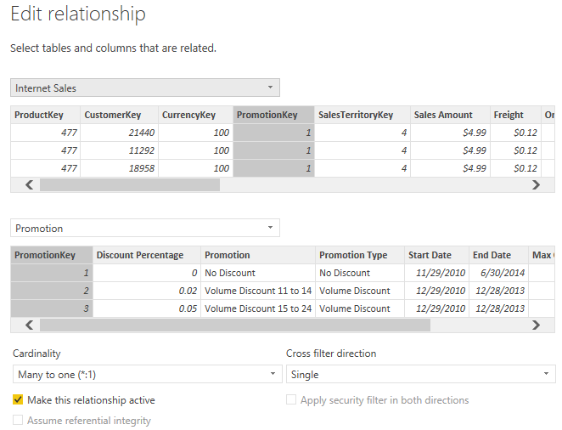
Relationship fundamentals
Row Identity
  Single Column Uniqueness Enforced
Referential Integrity
  In-Memory Mode: Not Enforced
  DirectQuery Mode: Defined by Author
Active and Passive
  Role Playing Dimensions
Crossfiltering
  Single and Bidirectional
Unambiguous Filter Path
  Single Relationship Path
Edit Relationships in Power BI Desktop
Notes:
Single Column Uniqueness: Unlike SSAS Multidimensional
Enforced for both import and DQ
Every relationship has a one side with a column of unique values:
if you load a duplicate value (Promotion Key), processing will fail
If you’re using a text column (which you don’t want to be doing) then know that it’s case insensitive
Ref Integrity Not Enforced:
Early arriving fact – you’ve sold something to customer #12 but you only have 11 customers in your dimension
It will let you load (process) fact table rows with customer IDs even if you don’t have those customer IDs in your customer table. (It will create a blank row)
Active/Passive:
See the checkmark here for relationship active – can have multiple relationships between tables
Most often used for role playing dimensions, it has other use cases
Example: active relationship based on order date, but I have two other inactive relationships based on due date, and ship date
Crossfiltering:
See that dropdown
For years Tabular models only had single cross filtering – filters flowed downhill only
Now they CAN flow ‘uphill’ too, if this doesn’t create an ambiguous filter path
Of course that doesn’t mean you should use them if you need them
Unambiguous Relationship path
Cannot create bidirectional relationship from Internet Sales to Product because
Filter on Sales Territory could flow south or north
See an example with Actual vs. Plan

Slide 11
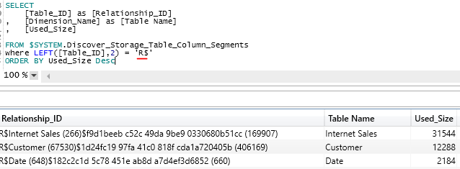
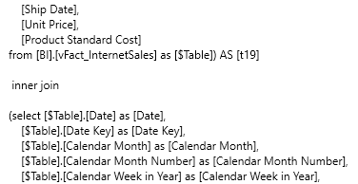
Relationships by storage mode
Import Mode
  Default Mode
  In-Memory
  Columnar and Compressed
  Many Data Sources Supported
  Multiple Sources per Model
DirectQuery Mode
  Near Real-Time Analytics
  Semantic Layer Only
  SQL Queries Sent to Source
  Limited Data Sources
  Single Database per Model
Relationship Structures of In-Memory Model per SSAS DMV
SQL Query Generated by DirectQuery Model
Notes:
We have two very different types of datasets - Import or DirectQuery – and relationships are handled a bit differently for each
There are many factors we don’t have time there’s a 67 page white paper
Two takeaways: A) there’s not a clear golden rule and B) you will give up performance with DQ even if you do everything right with dQ (for now)
However, DirectQuery is a strategic priority for Microsoft; (ideally you don’t want to copy the data)
In-Memory:
Import data on a schedule from one or more sources such as a DW
That data is compressed, it’s stored in columnar format. And it’s FAST. (
DQ:
You may need a model to show near real-time or you may have a very performant relational data source and not want or need to import the data
Brief demo: Query import mode model for relationship
With Import Mode the model creates relationship memory structures independent of the tables
These get updated with a process recalc operation
You can query them with this DMV:
If you have an early arriving fact it will just handle it – it will still process successfully and show a blank
Sold something to customer ID 123 and this customer is not in your
Assume you don’t have any ETL process that gives it a -1 value and joins it to an ‘unknown’
With DirectQuery mode
A SQL query gets generated: slice
One thing to note
You see that there’s an inner join here
There’s a property in DirectQuery models for ‘AssumeReferentialIntegrity’
If you set this to true, you get inner join. If not, outer join

Slide 12
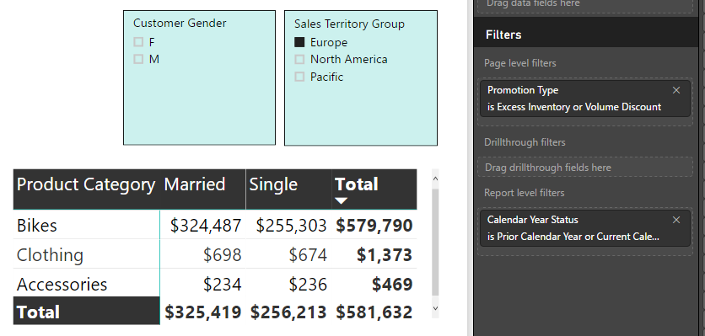
Relationships in filter context
Filter Context Detected
  Off Canvas + On Canvas
Calculate() or CalculateTable()
  Add, Remove, or Overwrite
Model Tables Filtered
Related Tables Filtered
  Single or Bidirectional
Metric Calculation Executed
  Filter context for each cell
Five Filters Applied to Matrix Cells (ex Subtotals)
Date Table = Current Year or Prior Year
Promotion Table = Excess Inventory or Volume Discount
Sales Territory Table = Europe
Product Table = Product Category (Rows)
Customer Table = Customer Marital Status (Columns)

Slide 13
Relationship patterns

Slide 14
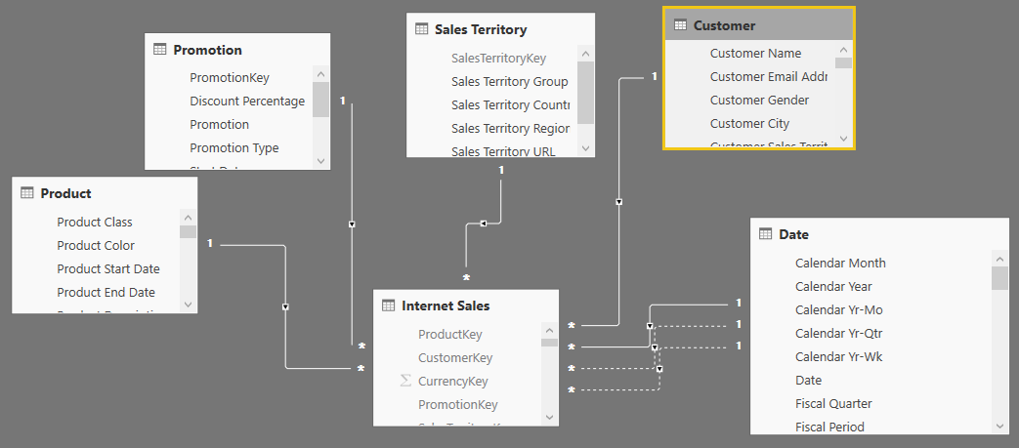
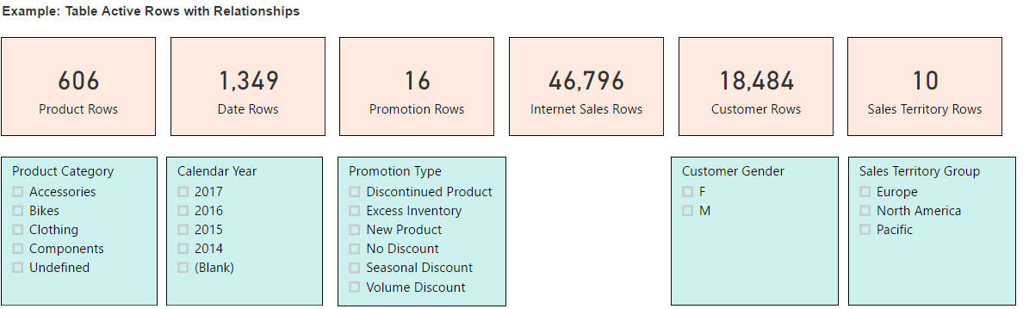
Getting started with Star schema
Main Benefits
  Usability
  Performance*
Single Direction Only
Demo:
  Active Rows
  Filter Context vs SQL Query
Star Schema Data Model
Row Count Metrics by Table to Indicate Filter Context
Notes:
Why an asterisk*
large dimensions such as 1M rows
Do I have a selective filter such as product category = ‘shoes’
What values are active on the table that’s filtered

Slide 15
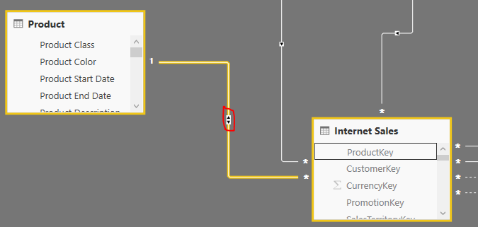
Intro to bidirectional relationships
Many-to-One Filter Context
Use Cases
  Many-to-Many
  Multiple Grains
  Row Level Security
  Edge Cases
CROSSFILTER()
  Measure-specific relationship filtering
Anti-Patterns
  Relationship to Date Table
  Common Dimension to Multiple Fact Tables
Bidirectional Relationship from Internet Sales to Product
Product Rows (Online Sales) = CALCULATE([Product Rows],
CROSSFILTER('Internet Sales'[ProductKey],'Product'[ProductKey],Both))
Bidirectional cross filtering via DAX
Notes:
Why an asterisk*
large dimensions such as 1M rows
Do I have a selective filter such as product category = ‘shoes’
What values are active on the table that’s filtered

Slide 16
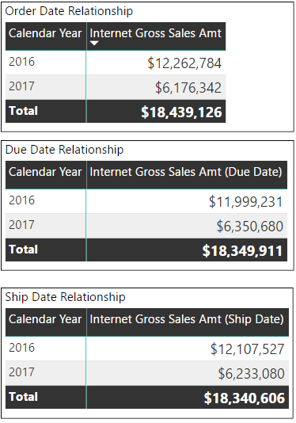
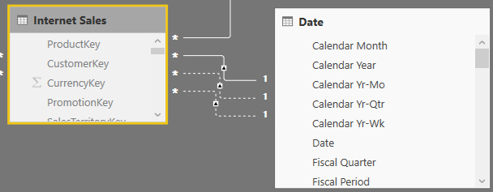
role playing dimensions
Role Playing Dimension Patterns
  Dedicated Tables vs. Passive Relationships
Usage/Frequency of Alternative Dates?
Date Table with Inactive Relationships
Notes:
Why an asterisk*
large dimensions such as 1M rows
Do I have a selective filter such as product category = ‘shoes’
What values are active on the table that’s filtered

Slide 17
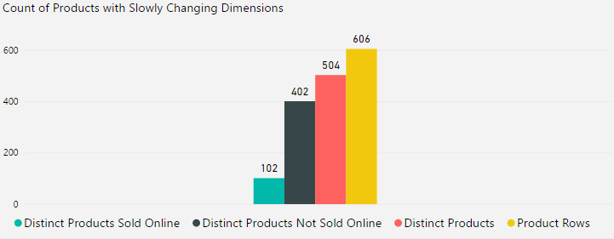
Dimension Measures
Example: Four Measures
Product Rows
Distinct Products
Distinct Products Sold
Distinct Products Not Sold
Multiple Definitions of Count of Products
Two Options
Invoke Filter Context of Fact Table
Bidirectional Relationship
Distinct Products Sold Online =
CALCULATE([Distinct Products],'Internet Sales’)
Distinct Products Not Sold Online = CALCULATE([Distinct Products],
FILTER(ALL('Product'[Product Alternate Key]),
ISEMPTY(RELATEDTABLE('Internet Sales’))
)
)
Filter Context via DAX
Notes:
Why an asterisk*
large dimensions such as 1M rows
Do I have a selective filter such as product category = ‘shoes’
What values are active on the table that’s filtered

Slide 18
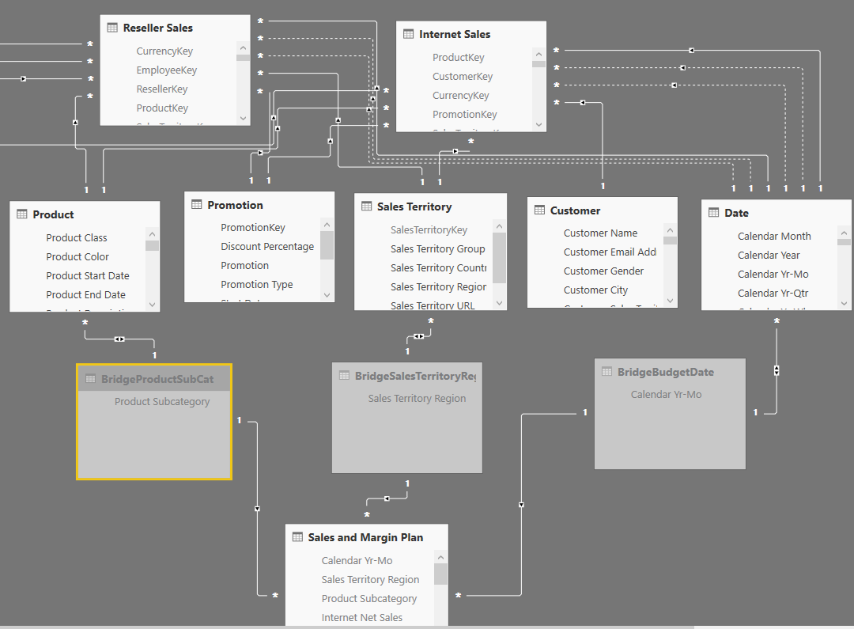
Actual vs. plan via bidirectional
Bridge Tables for Plan Grain
Bidirectional Relationships
  Dims to Bridge Tables
Single Relationships
  Bridge Tables to Plan
DAX Measures to Test Filter Context
Date Table with Inactive Relationships

Slide 19
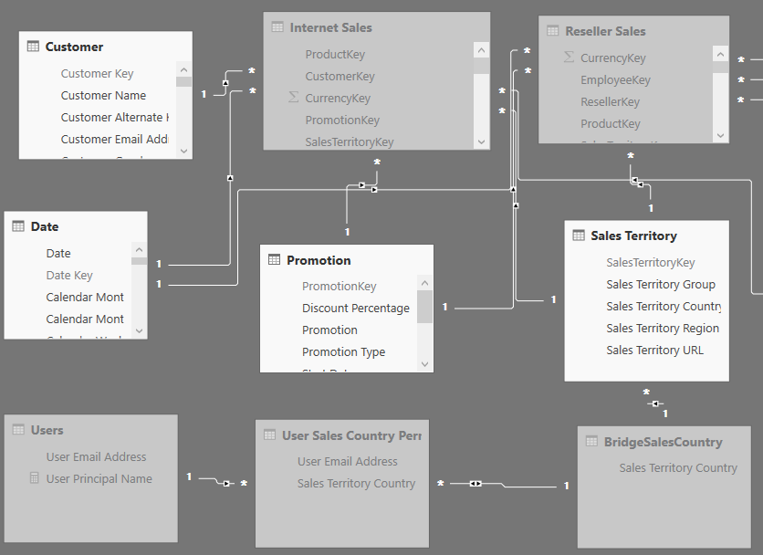

Dynamic Row Level Security
Users Table of UPNs
Permissions Table for Users
  Many Countries per User
Bridge Table of Countries
Bidirectional Relationship
Security Role:
  USERPRINCIPALNAME()
User and User Permissions Table for Dynamic Security
Users Table filtered by User Principal Name Measure

Slide 20
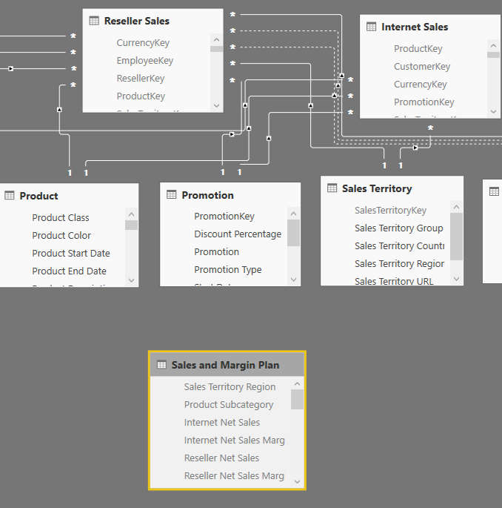
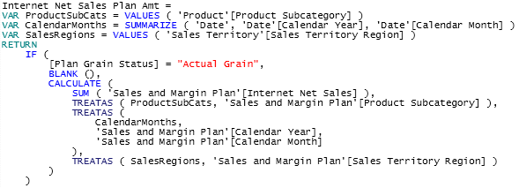
Actual vs. Plan via virtual relationship
DAX Measures to Filter Plan
DAX Measures to Test Filter Context
Plan Measure Filtered via DAX
No Physical Relationships to Plan

Slide 21
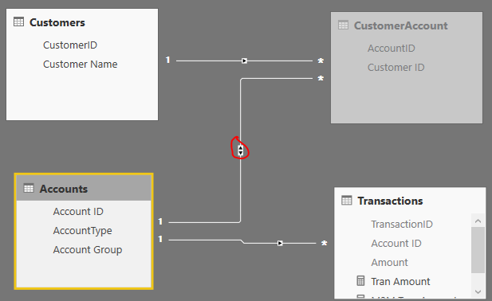
Many-to-Many Pattern
Scenario:
  Many Customers per Account
  Many Accounts per Customer
Pattern:
  Bridge Table of Customer Keys
  Bidirectional Relationship
    From Bridge to Accounts
DAX Alternative:
Filter Applied via DAX functions (TREATAS())
M2M Tran Amount =
CALCULATE([Tran Amount],
SUMMARIZE(CustomerAccount,Accounts[Account ID])
)

Slide 22
The End

